Slide 1
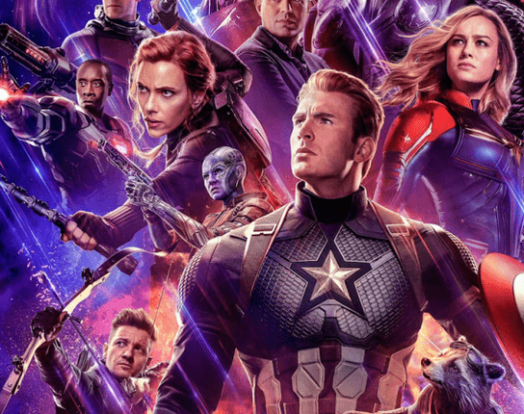
Avengers - Fitness Recommender
Author: Syafiq Azman
Contact: 0478664878
Email: syafiqazmn@gmail.com

Slide 2
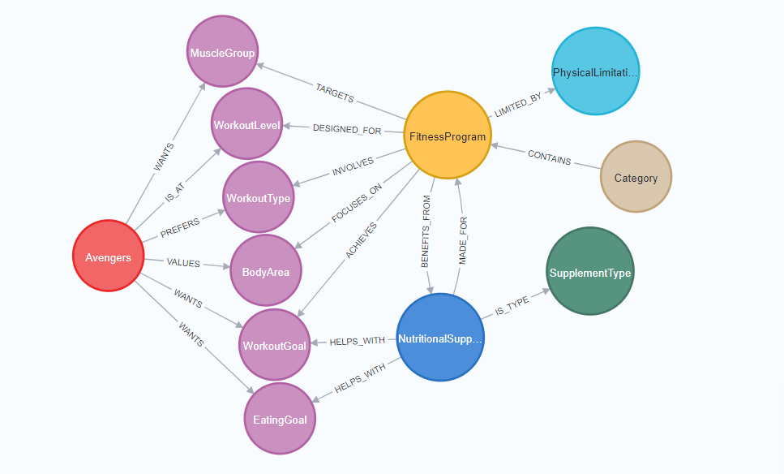
The Relationships

Slide 3
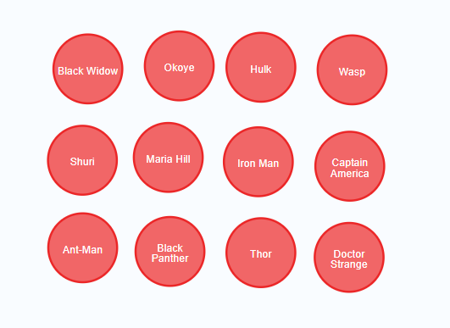
The Avengers

Slide 4
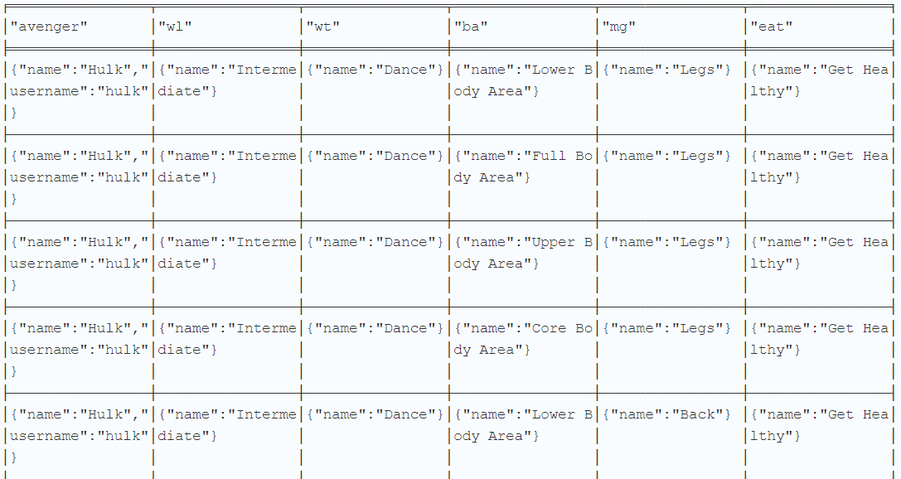
1. The Avengers and their fitness programs

Slide 5
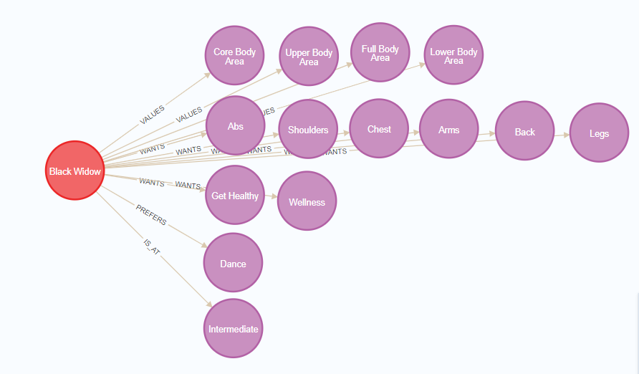
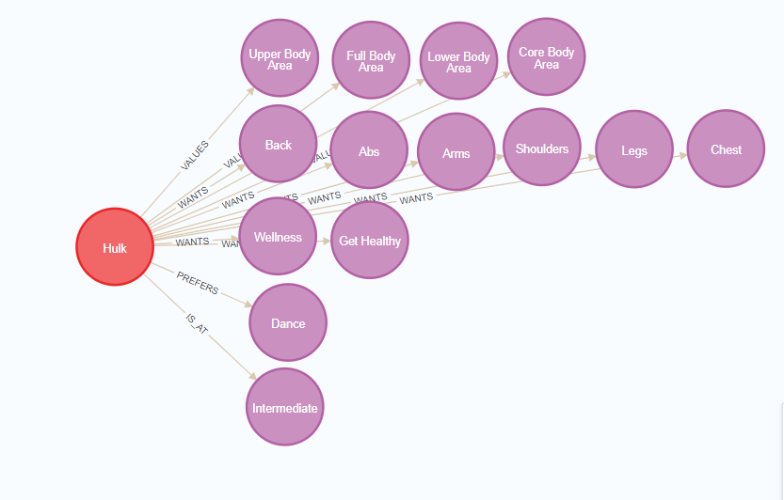
1. The Avengers and their fitness programs
Body Area
Muscle Group
Eating Goal
Workout Type
Workout Level

Slide 6
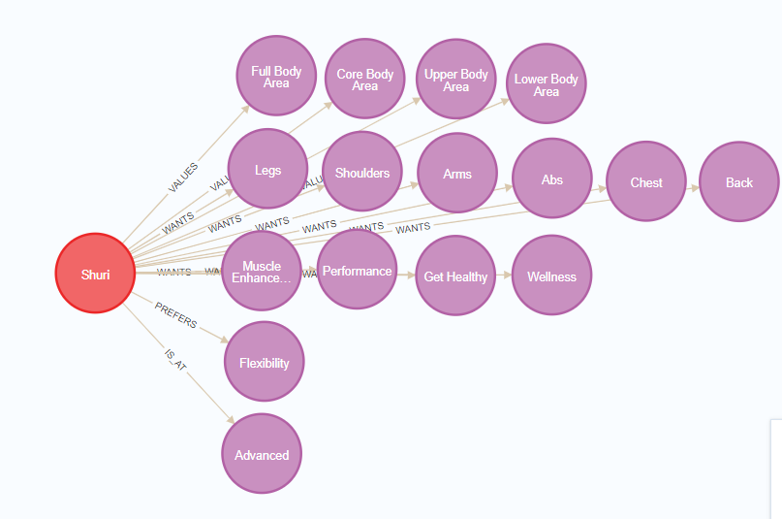
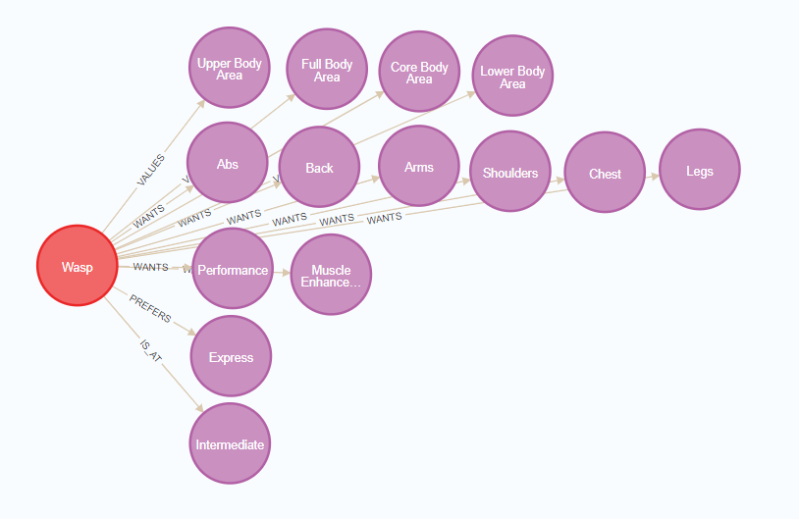
Avengers and their fitness programs

Slide 7
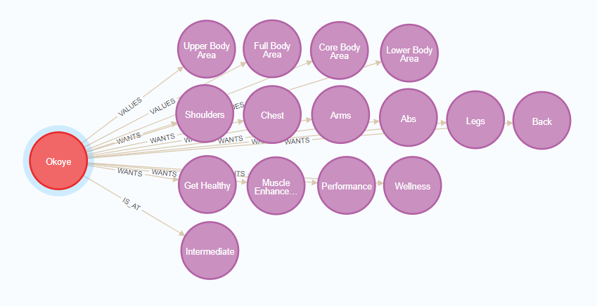
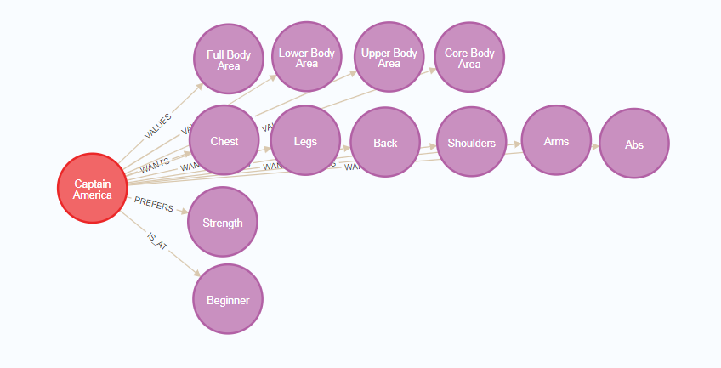
Avengers and their fitness programs
Notes:
okoye does not have workout type relationship
captain america no eating goal

Slide 8
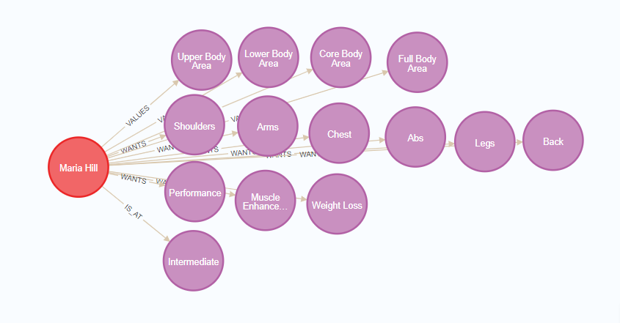
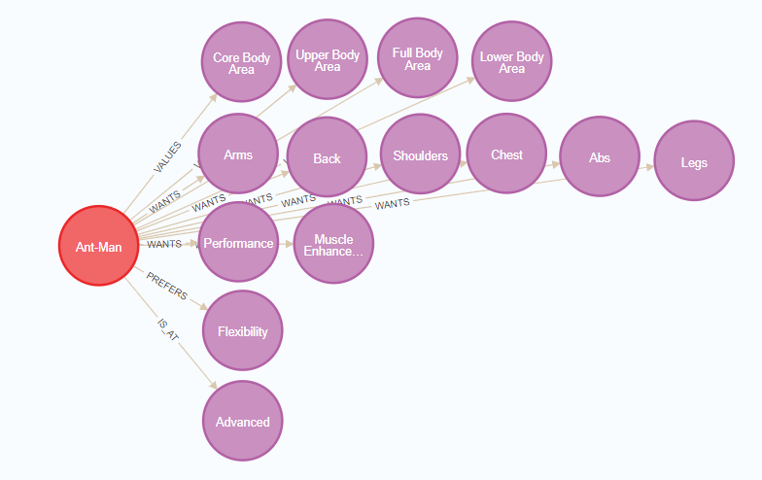
Avengers and their fitness programs
Notes:
maria hill no workout type

Slide 9
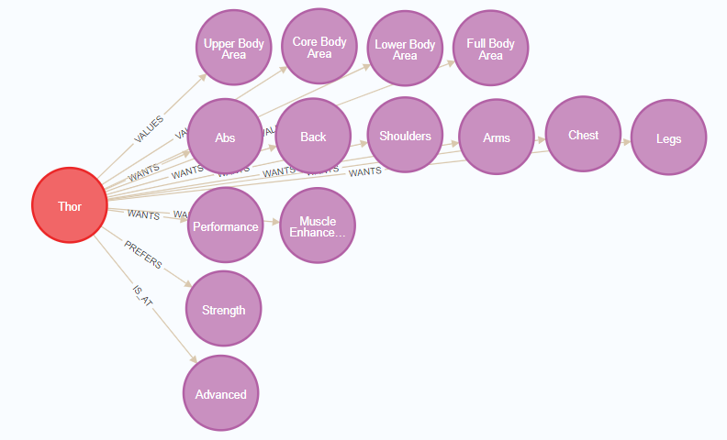
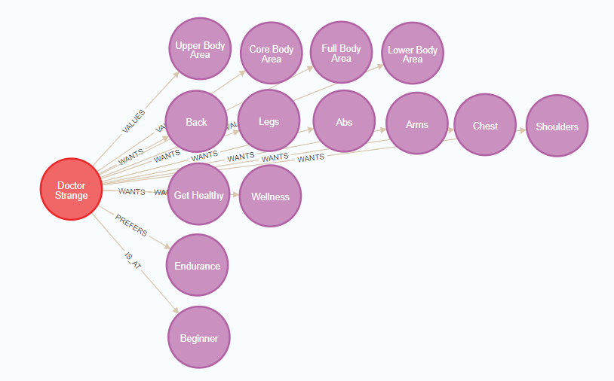
Avengers and their fitness programs
Notes:
black panther no eating goal

Slide 10
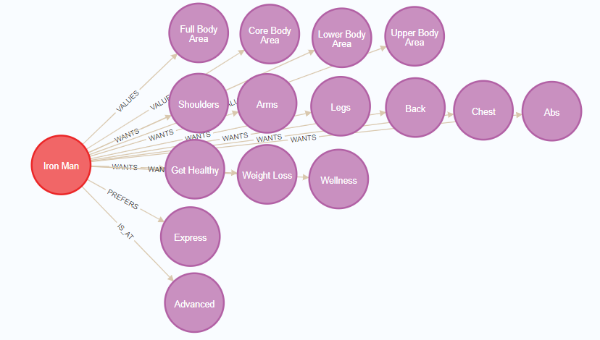
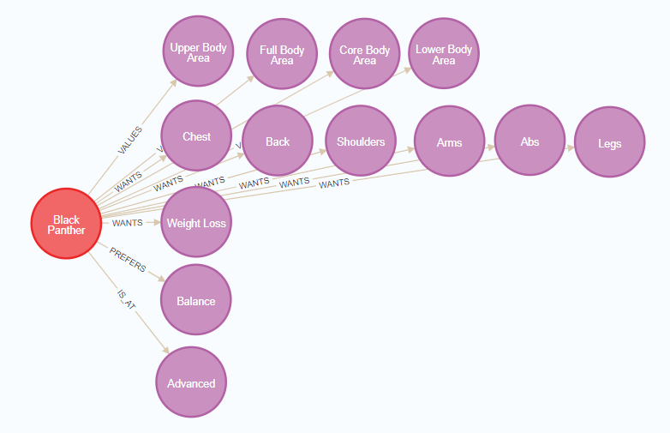
Avengers and their fitness programs

Slide 11
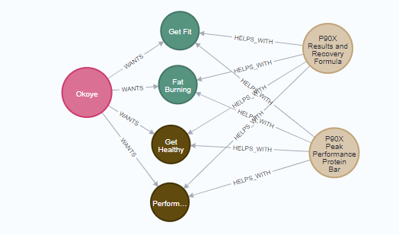
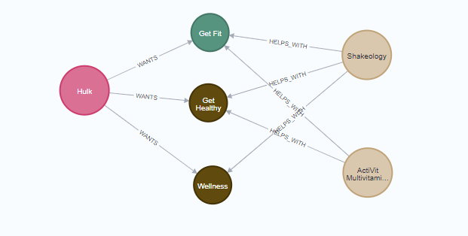
Avengers and their nutritional supplements

Slide 12
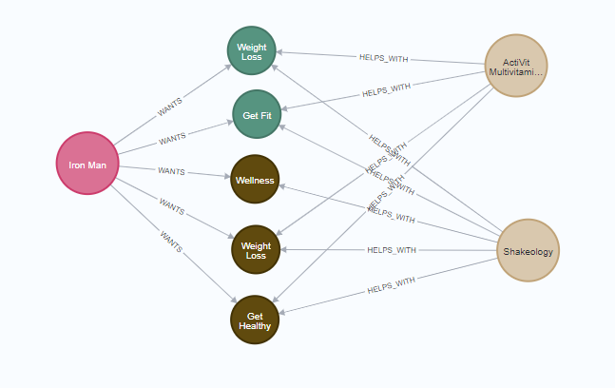
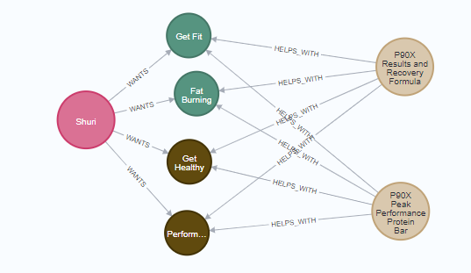
Avengers and their nutritional supplements

Slide 13
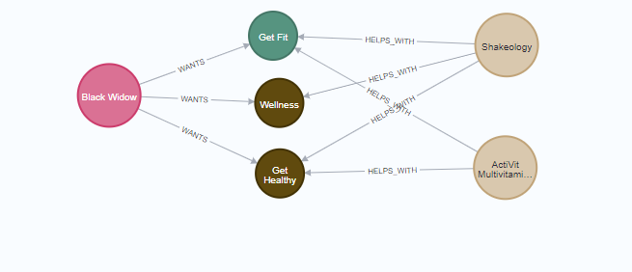
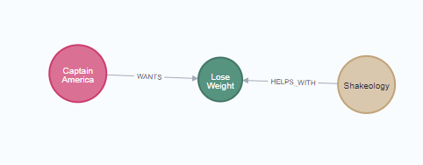
Avengers and their nutritional supplements

Slide 14
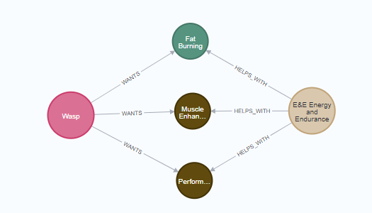
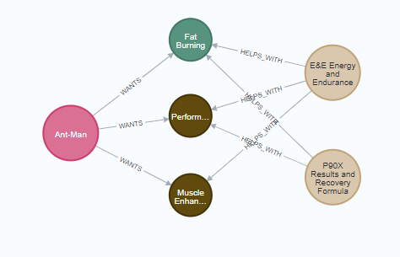
Avengers and their nutritional supplements

Slide 15
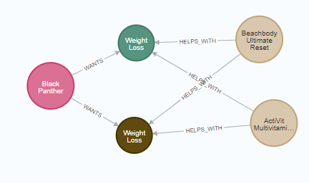
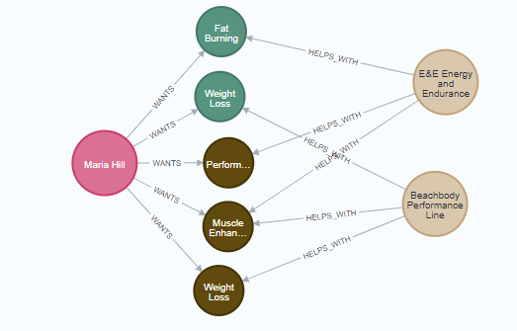
Avengers and their nutritional supplements

Slide 16
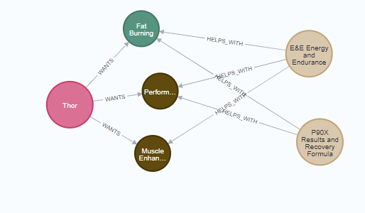
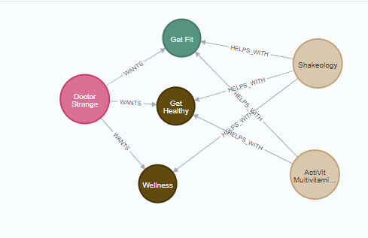
Avengers and their nutritional supplements

Slide 17
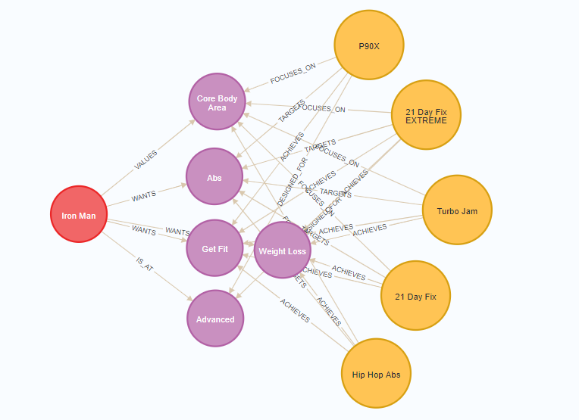
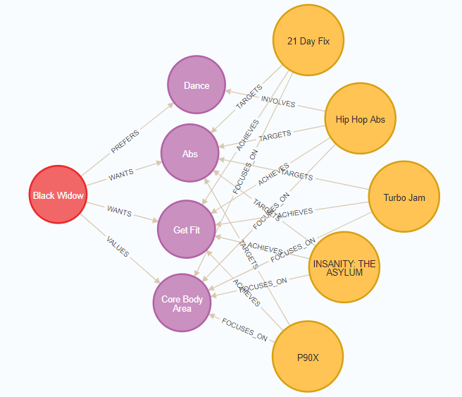
3. The Avengers – Fitness Personalisation

Slide 18
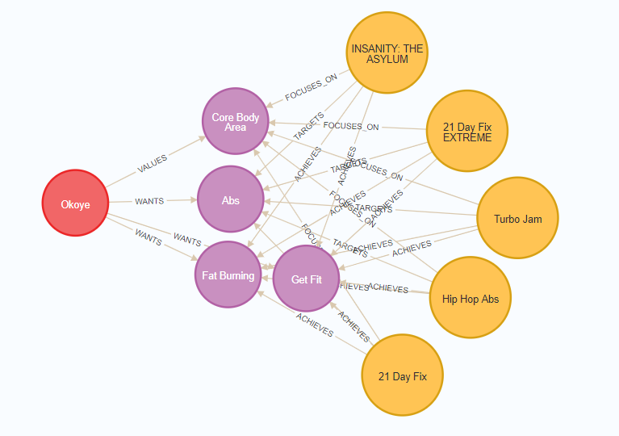
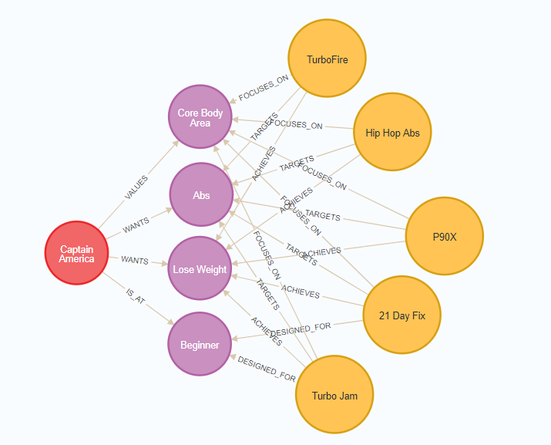
Fitness Personalisation

Slide 19
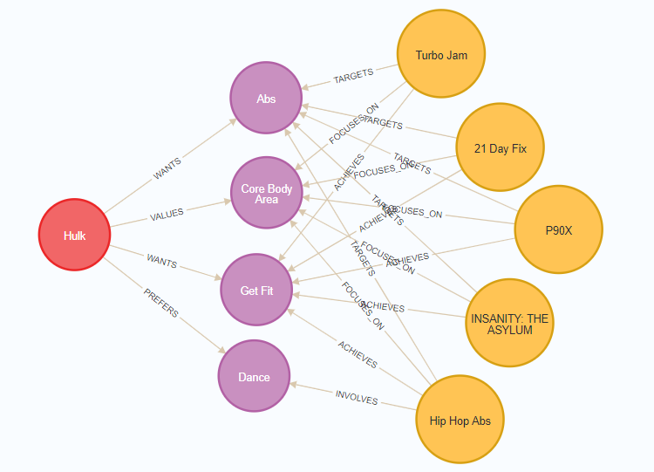
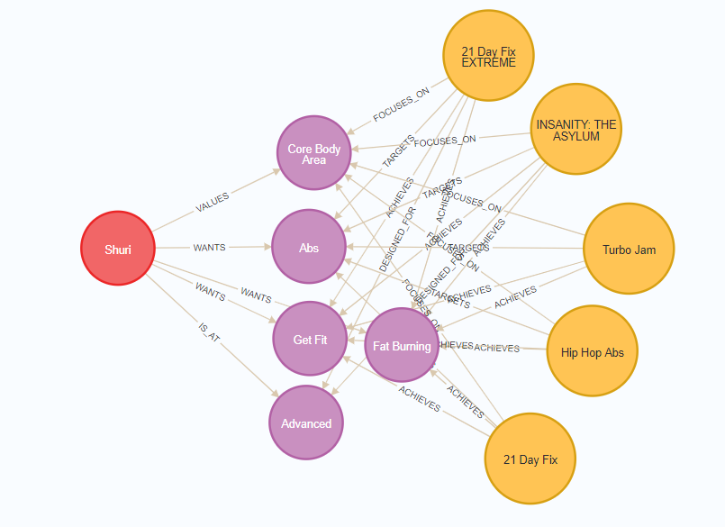
Fitness Personalisation

Slide 20
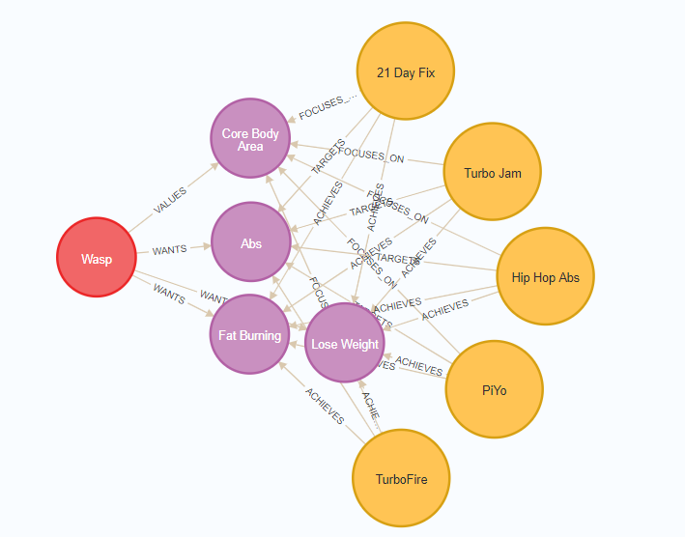
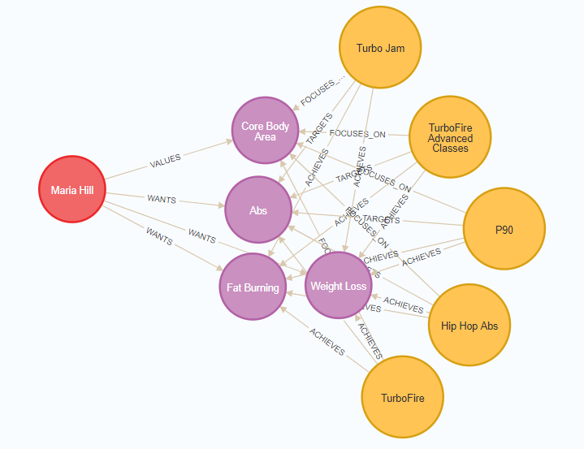
Fitness Personalisation

Slide 21
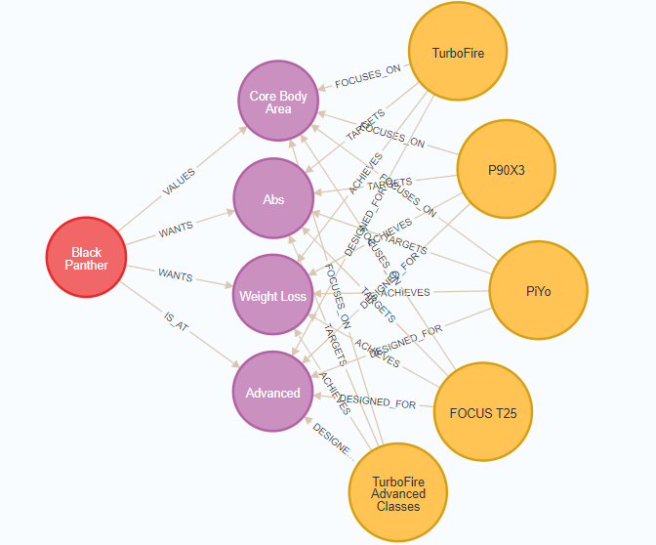
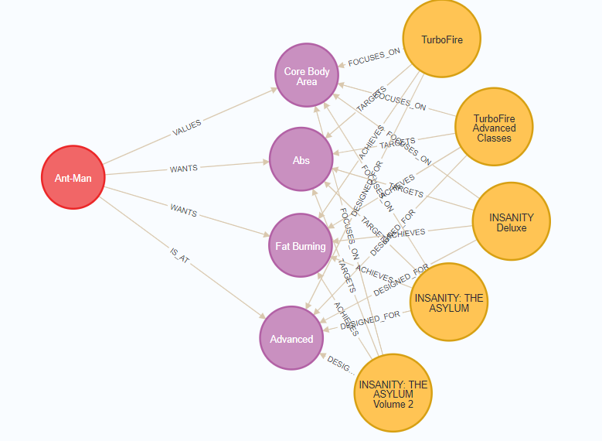
Fitness Personalisation

Slide 22
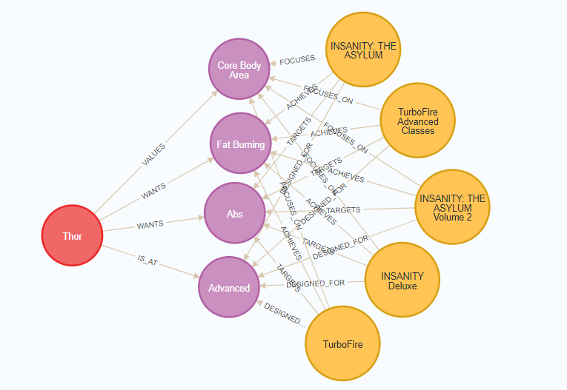
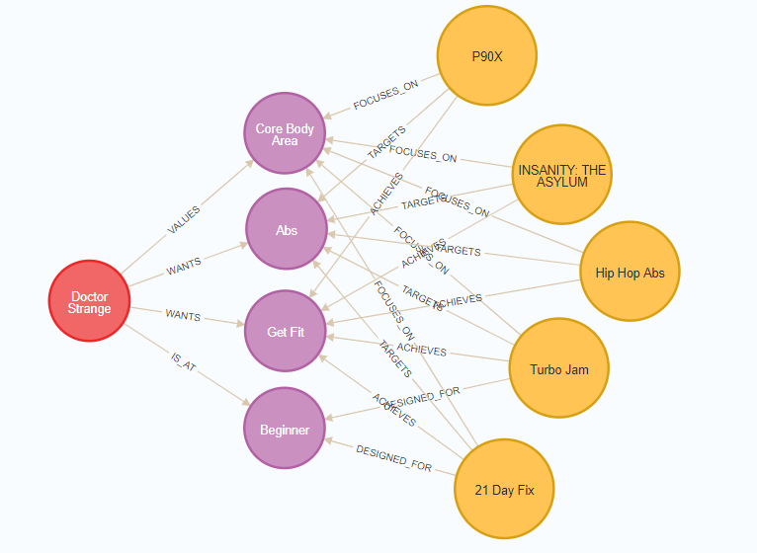
Fitness Personalisation

Slide 23
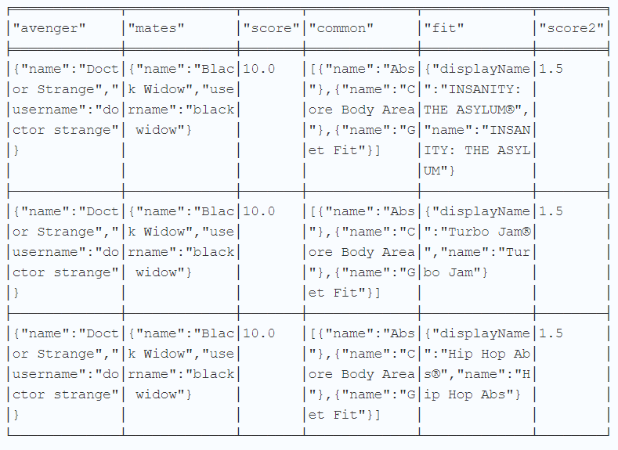
4. The Avengers – Workout Partner(s)
Notes:
example query table for doctor strange
the scores, sorted by descending order and limit by 3 so can see the top 3 recommendations as well as his workout partner which is

Slide 24
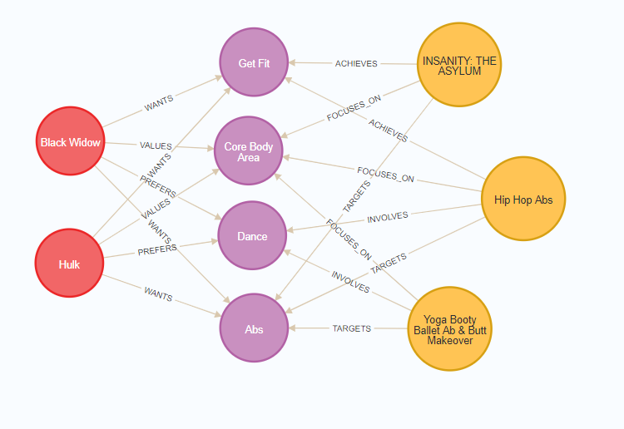
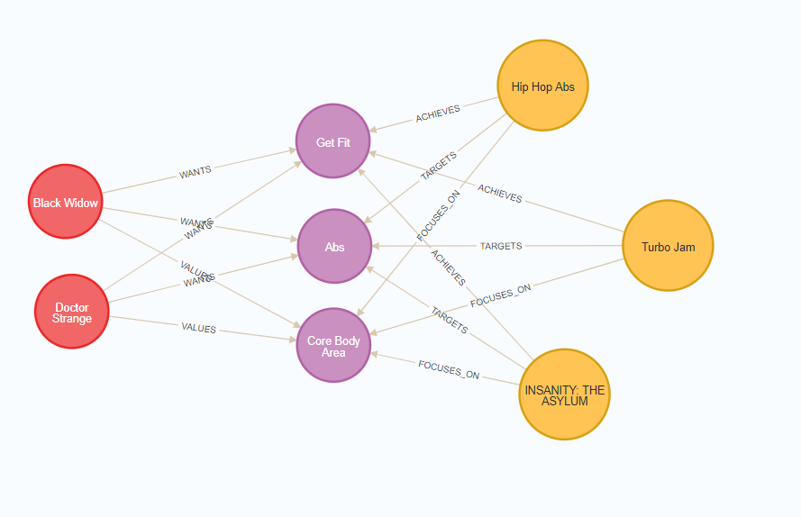
4. The Avengers – Workout Partner(s)
Notes:
doctor strange is partner with black widow
black widow is partner with hulk

Slide 25
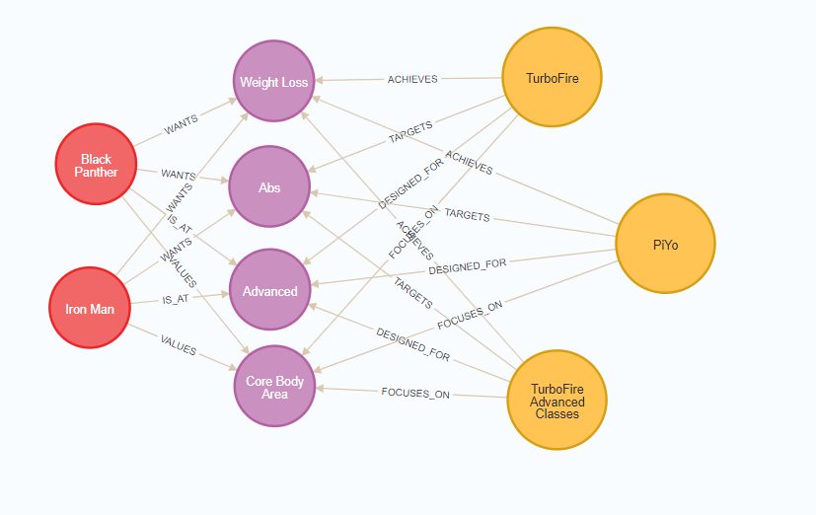
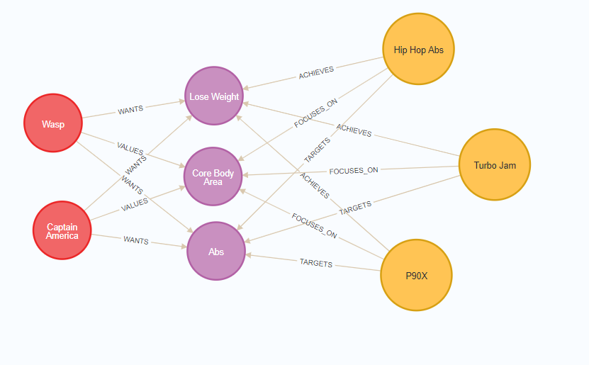
Workout Partner(s)
Notes:
black panther is partner with iron man
captain america is partner with wasp

Slide 26
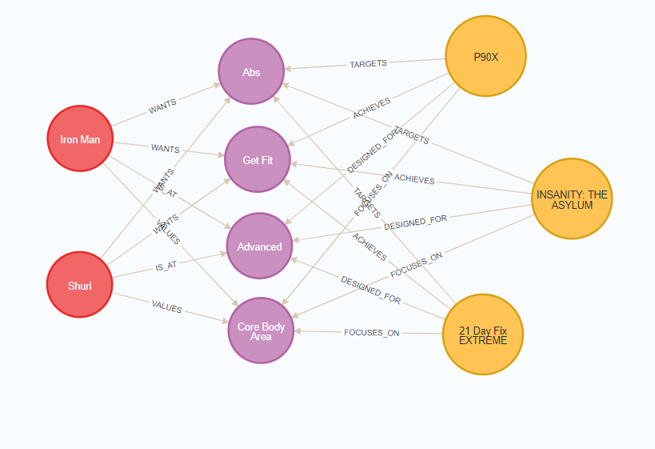
Workout Partner(s)
Notes:
iron man is partner with shuri

Slide 27
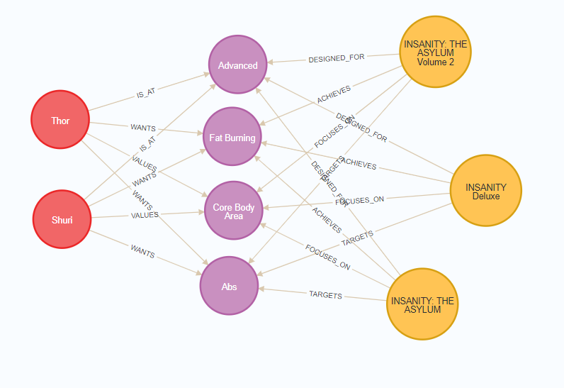
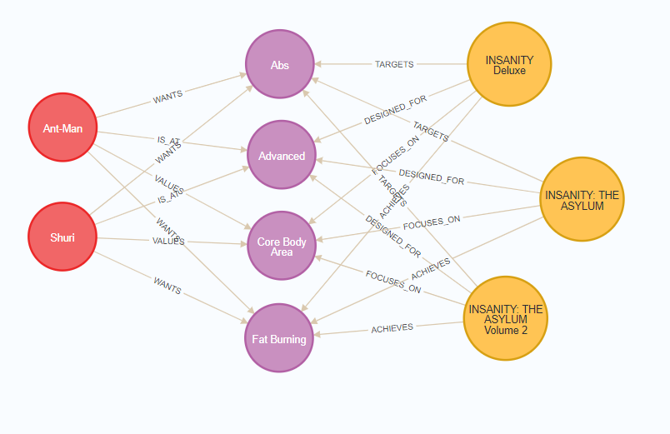
Workout Partner(s)
Notes:
thor is partner with shuri
ant man partner with shuri

Slide 28
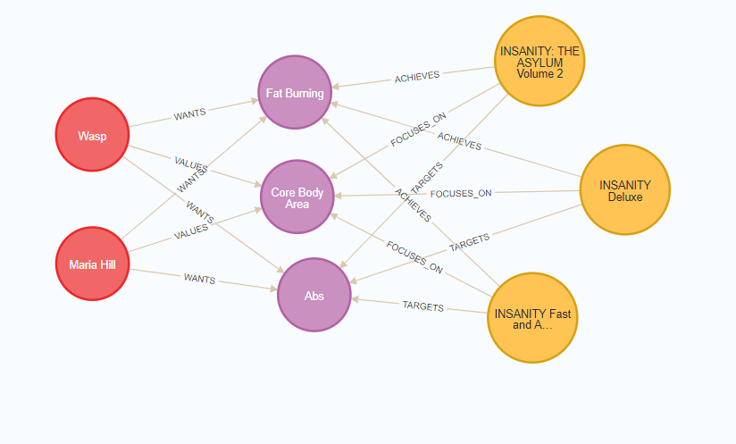
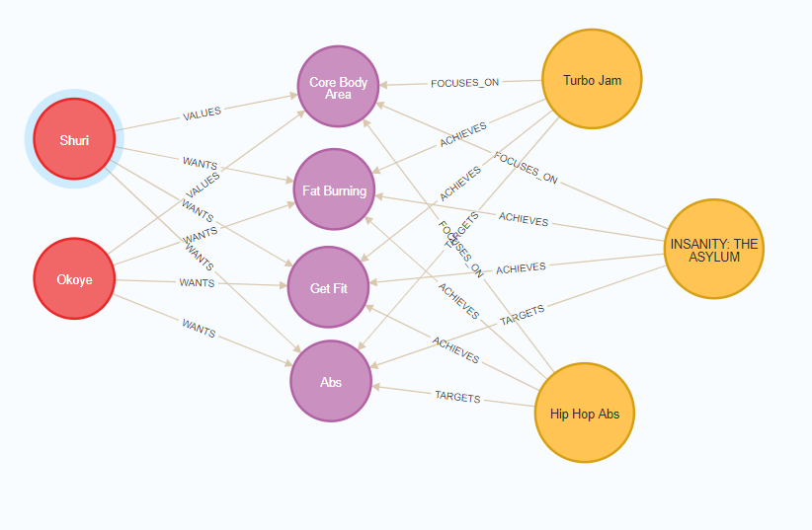
Workout Partner(s)
Notes:
wasp and maria & shuri and okoye are same partners with each others
Insights: Shuri is the highest workout partner that was recommended for other avengers, Shuri is partner for Okoye, Iron man, ant man, thor, she is the most compatible as a workout partner in the avengers

Slide 29

Q and A

Slide 30

Thank You!

